Slide 1


IE41201 Advanced Investment Science
Korean Pension Funds
Portfolio Optimization
20161342 Keonwoo Kim
Notes:
Hello my name is keonwoo kim, and I’ll present my project about ‘Korean pension funds portfolio optimization’.

Slide 2

2
CONTENTS
1. Introduction
4. Additional Works
- Basic description of client
- Compare with actual values
2. Financial Planning
5. Conclusion
- Robust optimization, Simulation
- Limitations and Expectation
3. Progress Report
- Portfolio Evaluation, New Strategy suggestion
Notes:
This is overall contents of presentation. I’ll present the introduction first, then, presentation will be made in order of ‘financial planning’, ‘progress report’, ‘additional works’ and ‘conclusion’.

Slide 3


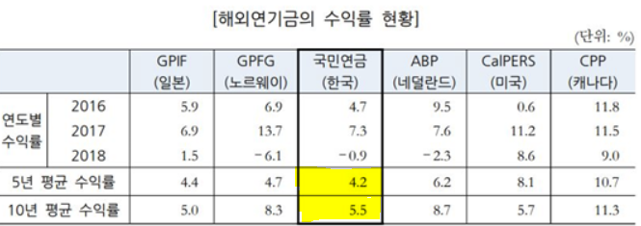
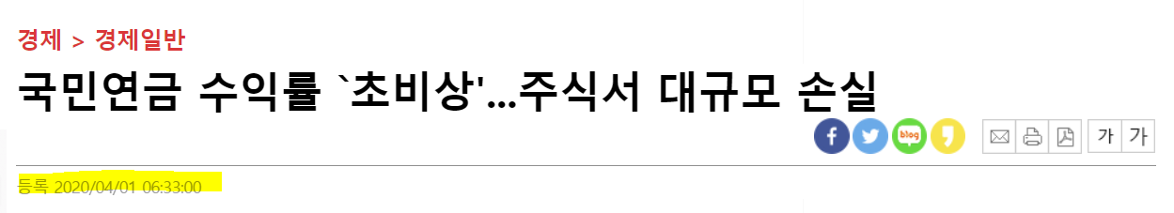
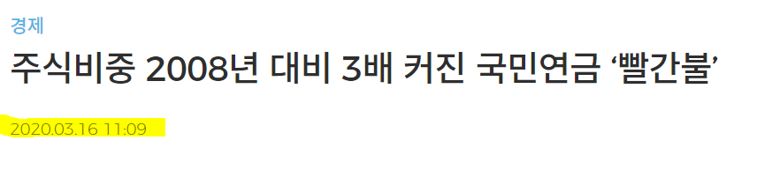
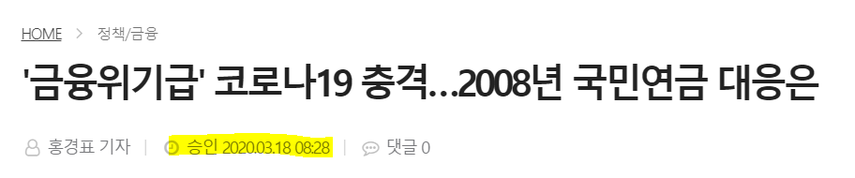

1. Introduction
Client: Korean Pension Fund
Table of the current status of return on overseas pension funds (2016~2018)
Notes:
Now, I’m going to talk about basic description of client. Client was selected as Korean Pension Fund which is an institutional investor.
To describe client’s problem, compared to the average return of pension funds in other developed countries and South Korea, the return rate for Korean Pension Fund is relatively low. Even considering the different size of each country’s pension fund’s asset management and the proportion of its investment in bonds and stocks, it seems to show poor performances. Also, if you look at the performance of National Pension Fund investment management in 2020 first quarter, it’s been pretty low like the news here. So I thought these were also problems of national funds.
So I set client’s objective as making stable profits by investing in stocks up to 6~8% per year in a year (2020). One of the most important pension funds’ roles is to have responsibility for the retirement of the Korean people. Also, in the event of a national economic crisis, pension fund should contribute to index funds and economic recovery. Thus, it needs to have always charged capital from stable and profitable investment.

Slide 4
2. Financial Planning
Planning Period: 2020.01.02 to 2020.12.31, right after the outbreak of COVID-19 based on 2018~2019 historical data.
- Rebalancing Periods: Every quarter 2020.04.01, 2020.07.01, 2020.10.01 (first investment: 2020.01.01)
Assumptions
1) Portfolio manager and investors are now on 2020.01.01. So stock prices since 2020.01.01 are completely unknown
2) The National Pension Fund’s investment is a considerable amount of 700 trillion Won, but to put it more concisely, the project uses the investment at 1 million won.
3) The National Pension Funds actually invests in various products including real estate, bonds, stocks and etc.
But in this project, we assume to invest only in bonds and stocks because there is a limit to considering all products
4) Considering all domestic and foreign bonds and stocks is practically difficult to handle. Only six domestic stocks and six domestic bonds were used.
5) Both stocks and bonds are designated as ETF related products.
Data:
1) Stocks: KODEX 200, KODEX KOSDAQ 150, KODEX LEVERAGE, KODEX KOSDAQ LEVERAGE 150,
KODEX SAMSUNG,TIGER TOP 10
2) Bonds: KODEX 10Y F-LKTB, KODEX Treasury Bond 3Y, KODEX KRW Cash, KOSEF Enhance Cash,
TIGER Money Market, KOSEF 10Y KTB
Notes:
Now it is the financial planning part. Planning period was set to 2020.01.02 to 2020.12.31 which is a chaotic time when COVID-19 was the most serious.
And the rebalancing periods was set every quarter which is April 1, July 1, October 1, also we should also consider first investment on January 1. The investment is based on the historical data from 2018~2019, and every time we rebalance, we invest in consideration of all the new historical data.
And there are five main assumptions in financial planning.
1) Portfolio manager and investors are now on 2020.01.01. So stock prices since 2020.01.01 are completely unknown
2) The National Pension Fund’s investment is a considerable amount of 700 trillion Won, but to put it more concisely, the project uses the investment at 1 million won.
3) The National Pension Funds actually invests in various products including real estate, bonds, stocks and etc. But in this project, we assume to invest only in bonds and stocks because there is a limit to considering all products
4) Considering all domestic and foreign bonds and stocks is practically difficult to handle. Only six domestic stocks and six domestic bonds were used.
5) Both stocks and bonds are designated as ETF related products.
In addition to the five assumptions I just mentioned, there are many minor assumptions in this project, and I will explain them together as I proceed with the project.
And the stocks used in investment are shown here. Six shares, six bonds.

Slide 5
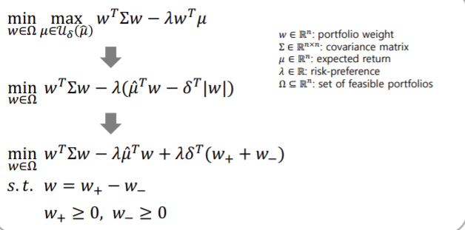
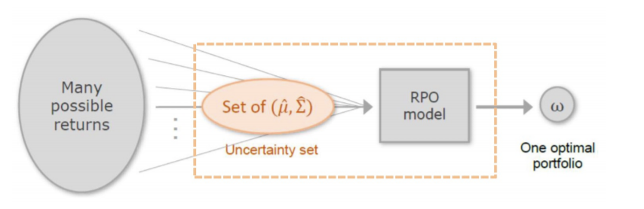
2. Financial Planning
Methods: Robust Portfolio Selection
-> Robust portfolios under box uncertainty
-> Box (interval) uncertainty set
Notes:
Makrowitz mean-variance portfolio optimization is utilized to solve out portfolio weights using ‘Robust portfolio selection’ to achieve client’s objective. The reason for choosing this method is that the results of robust optimization have characteristics that are insensitive to small deviations. Also, among diverse uncertainty set such as ball uncertainty, ellipsoidal uncertainty etc., I only chose ‘box uncertainty’ set on this algorithm.
Thus, we can optimize optimal portfolio weights under worst case. Set the financial plans considering worst case would be well and it is a lot like the investment situation in COVID-19.

Slide 6
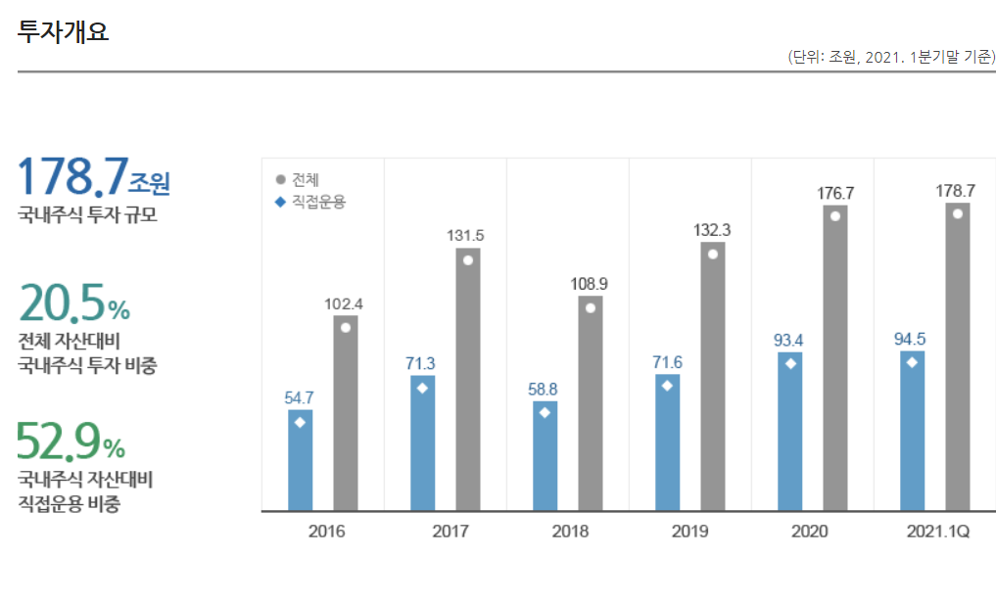
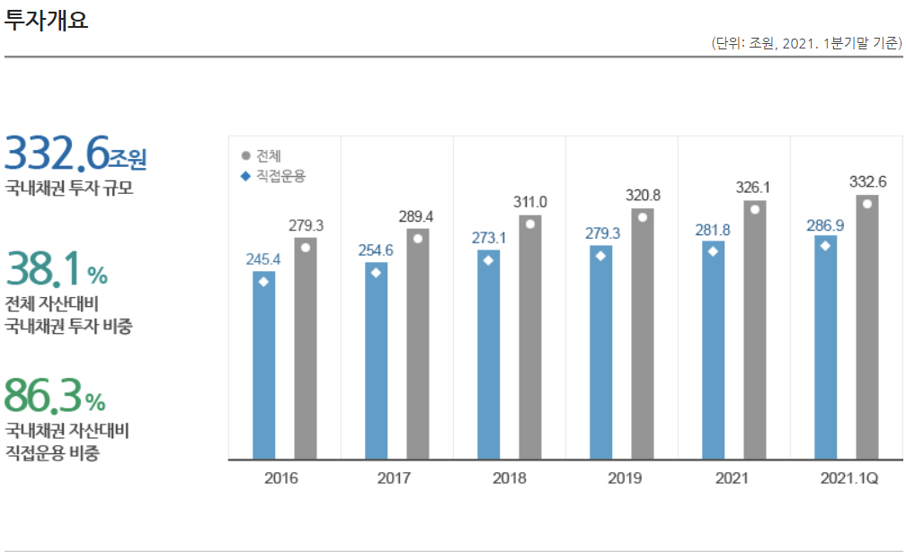
2. Financial Planning
Actual proportion of the National Pension Fund’s domestic Portfolio
Domestic stocks amount of investment
Domestic bonds amount of investment
Notes:
Before, entering simulation, we should specify how much the National Pension Fund’s portfolio is constructed on Domestic products. The left table indicates domestic stocks amount of investment, and the right table indicates domestic bonds amount of investment.
Domestic stock investment is approximately 178 trillion won and domestic bond investment is 332 trillion won, which tends to invest 1.7 times more in relatively stable bond products from a risk perspective. To show realistic results in our financial planning as well, we will proceed by adding the above conditions to the constraint on robust optimization.

Slide 7
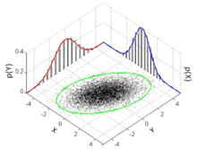
2. Financial Planning
Simulation:
Steps
Generate random 1000 samples return by using multi-variate normal distribution
Run robust optimization on each sample by rebalancing on each quarter.
Update each expected return while rebalancing on one iteration which refers to one sample
Save each sample wealth, calculated by multiplying weights from optimization and amount of investment
Multi-variate normal distribution
Notes:
Steps for simulation is followed as 4 steps.
1) Generate random 1000 samples return by using multi-variate normal distribution
2) Run robust optimization on each sample by rebalancing on each quarter.
3) Update each expected return while rebalancing on one iteration which refers to one sample
4) Save each sample wealth, calculated by multiplying weights from optimization and amount of investment

Slide 8
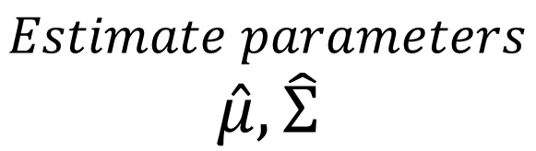
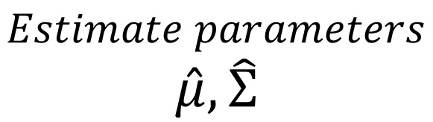
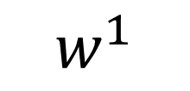
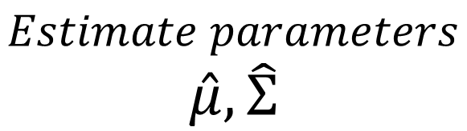
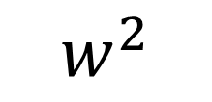
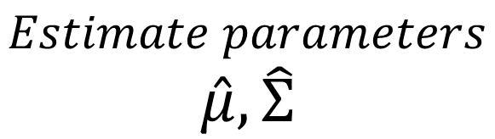
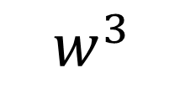
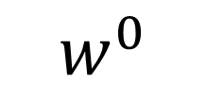
2. Financial Planning
Robust optimization
Robust optimization
Robust optimization
Robust optimization
$$Estimate parameters$$
$$\hat{μ},\hat{Σ}$$
$$Estimate parameters$$
$$\hat{μ},\hat{Σ}$$
$$Estimate parameters$$
$$\hat{μ},\hat{Σ}$$
$$Estimate parameters$$
$$\hat{μ},\hat{Σ}$$
$$w^{0}$$
$$w^{1}$$
$$w^{2}$$
$$w^{3}$$
2018~2019
historical data
2018.04.01 ~
2020.03.31
2018.07.01 ~
2020.06.30
2018.10.01 ~
2020.09.30
Time
Buy-and-hold
Buy-and-hold
Buy-and-hold
Notes:
This is overview of simulation investment. First, we calculate estimate parameters based on 2018~2019 historical data. Then, we solve out weights by using robust optimization. That is first investment in 2020.01.01. With buy-and-hold method, we assume to keep our money to stocks and bonds that period, and selling all of them on the last day of first quarter which means change products into cash again .
Second, we solve out new estimate parameters based on first quarter history data and calculate new weights by robust optimization. Then, we reinvest products with money taken into account from past investments to returns. The important assumption in here is that, the period which is considered while calculating new estimators, we do not only consider first quarter since it has small numbers of data. I used ‘moving window’ method to keep same length of period, which means needing 2 years historical data to calculate parameters.
I did this same procedure for each quarter. And it is one simulation.
I did this whole same process for 1000 times to make diverse kinds of simulations.

Slide 9
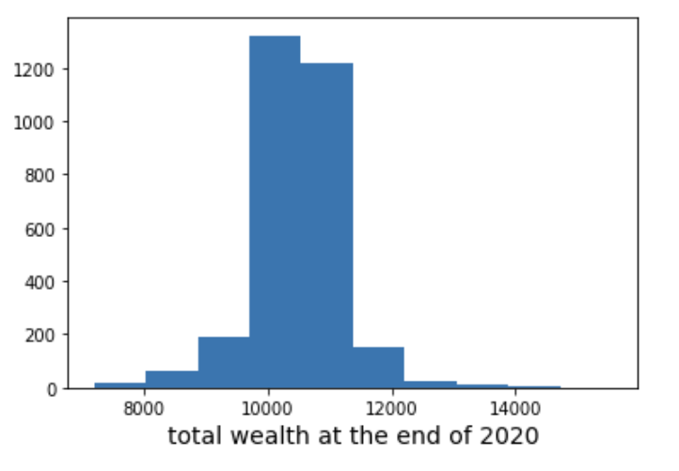
2. Financial Planning
Simulation Results:
Rebalanced period
First (01.01~03.31) | Average expected return | 5.79%
 | Average expected std | 3.62%
Second (04.01~06.30) | Average expected return | -0.04%
 | Average expected std | 1.72%
Third (07.01~9.30) | Average expected return | -0.26%
 | Average expected std | 1.72%
Fourth (10.01~12.31) | Average expected return | -0.02
 | Average expected std | 1.72%
Average of expected amount of money at the end of 2020: $10496
Notes:
This our results for simulation.
I solved out the average expected return and standard deviation for each rebalanced period.
Also, I calculated overall average of samples’ total remaining money at the end of 2020, and distribution of it.
Investing with $10000 amount, since the proportion of distribution in 10000~11000$ section was the largest, it is highly likely that the amount of money in this section will come out as the expected amount of money.
And with these simulation results, I will suggest to Korean Pension Fund to invest money on stocks and bonds with following strategy.
I strongly believe that the results on this strategy is attractive strategy to Pension Fund by seeing results from 1000 simulations.
Average of expected amount of money at the end of 2020: $10496

Slide 10
3. Progress Report
Robust optimization
Robust optimization
Robust optimization
Robust optimization
$$Estimate parameters$$
$$\hat{μ},\hat{Σ}$$
$$Estimate parameters$$
$$\hat{μ},\hat{Σ}$$
$$Estimate parameters$$
$$\hat{μ},\hat{Σ}$$
$$w^{0}$$
$$w^{1}$$
$$w^{2}$$
2018~2019
historical data
2018.01.01 ~
2020.03.31
2018.04.01 ~
2020.06.30
Time
Buy-and-hold
Buy-and-hold
Notes:
Progress report is made halfway through the total investment planning period, which is on the end of second quarter in 2020.

Slide 11
3. Progress Report
Type | Period: 2020.01.01~2020.03.31 | Weight
Bond | KODEX 10Y F-LKTB | 0.000
 | KODEX Treasury Bond 3Y | 0.091
 | KODEX KRW Cash | 0.311
 | KOSEF Enhance Cash | -0.050
 | TIGER Money Market | -0.049
 | KOSEF 10Y KTB | 0.365
Stock | KODEX 200 | 0.533
 | KODEX KOSDAQ 150 | 0.000
 | KODEX LEVERAGE | -0.049
 | KODEX KOSDAQ LEVERAGE 150 | -0.049
 | KODEX SAMSUNG | -0.050
 | TIGER TOP 10 | -0.049
 | Total bond Weight / Total stock weight | 66.7% / 33.3%
 | Expected Return / Standard Deviation | 1.77% / 0.03%
Total Wealth movement
$10000 (Jan 1)-> $9528 (March 31)
Notes:
This table shows the first period result. First period’s total wealth decrease to 9528$.

Slide 12
3. Progress Report
Type | Period: 2020.04.01~2020.06.30 | Weight
Bond | KODEX 10Y F-LKTB | 0.000
 | KODEX Treasury Bond 3Y | -0.05
 | KODEX KRW Cash | 0.677
 | KOSEF Enhance Cash | -0.049
 | TIGER Money Market | -0.05
 | KOSEF 10Y KTB | 0.140
Stock | KODEX 200 | 0.533
 | KODEX KOSDAQ 150 | 0.000
 | KODEX LEVERAGE | -0.050
 | KODEX KOSDAQ LEVERAGE 150 | -0.049
 | KODEX SAMSUNG | -0.050
 | TIGER TOP 10 | -0.049
 | Total bond Weight / Total stock weight | 66.7% / 33.3%
 | Expected Return / Standard Deviation | 2.16% / 0.03%
Total Wealth movement
$ 9528 (April 1)-> $9978 (June 30)
Notes:
This table shows the second period result. Second period’s total wealth increases to 9978$.

Slide 13

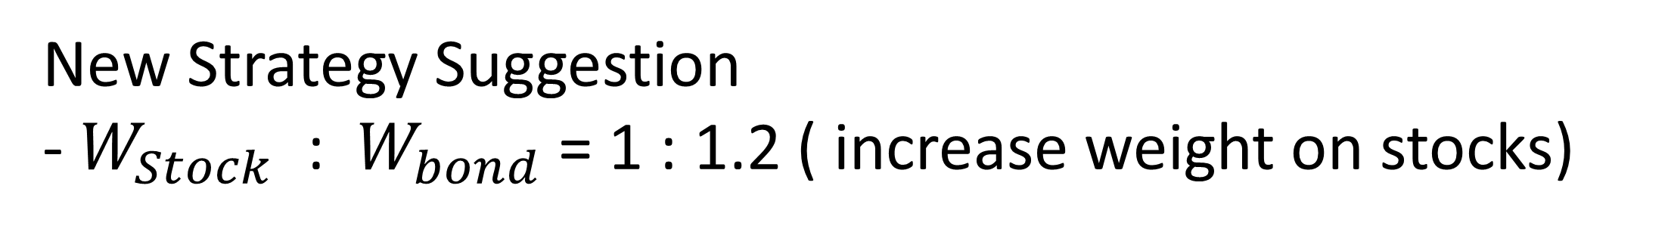

4. Progress Report
Portfolio Evaluation – the time weighted rate of return (geometric mean return)
$$R_{T}=−1.13\%$$
New Strategy Suggestion
- $W_{Stock}$ : $W_{bond}$ = 1 : 1.2 ( increase weight on stocks)
Notes:
The portfolio evaluation is conducted by the time weighted rate of return which is geometric mean return. Until June30, the return is calculated up to -1.13% which shows very poor performance.
In order to reach our objective which is 6~8% return at the end of 2020, I suggest new strategy to Pension Fund.
It is to adjust the weight of stocks and bonds, and we will revise our strategy to give the former a little more weight. If the yield was good in the interim report, it would have taken a less risky strategy, i.e., increased the portion of bonds. However, the interim results are not so, so the I plan to change its aggressive investment strategy to increase its share of stocks.

Slide 14
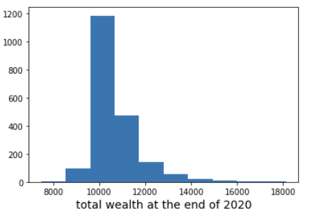
2. Financial Planning
Simulation Results:
Rebalanced period
First (07.01~09.30) | Average expected return | 9.67%
 | Average expected std | 4.82%
Second (10.01~12.31) | Average expected return | -0.28%
 | Average expected std | 2.44%
Average of expected amount of money at the end of 2020: $10689
Notes:
This our results for new simulation.
I solved out the average expected return and standard deviation for each rebalanced period.
Also, I calculated overall average of samples’ total remaining money at the end of 2020, and distribution of it.
Investing with $9778 amount, which is total wealth amount at the end of second quarter investment, since the proportion of distribution in 10000~11000$ section was the largest, it is highly likely that the amount of money in this section will come out as the expected amount of money. It would be new attractive strategy to Korean Pension Fund.
Average of expected amount of money at the end of 2020: $10689

Slide 15
5. Additional Works
Compare with actual historical data on 2020 with first suggested financial planning
First suggested strategy: total wealth $10391 at the end of 2020.
Portfolio Evaluation by time weighted return: -0.02%
Notes:
I did additional works which compare with actual historical data on 2020 with first suggested financial planning. Since I just explained the portfolio evaluation based on second quarter, I’ll now explain portfolio evaluation until at the end of 2002. Total wealth is calculated to $10391 and portfolio evaluation by time weighted return is calculated to -0.02% at the end of 2020.

Slide 16


6. Conclusion
Notes:
Even though I tried portfolio optimization, return was not good with that strategy due to COVID-19 in 2020. It arouses financial crisis in all the countries on Earth, it was hard to make good performance. However, I’m curious about how the outcome is comes out if I do not use several assumptions I mentioned and realized them. The results may come out different.

Slide 17
THANK YOU
Notes:
Thank you for listening my presentation.

